Slide 1
Fake News detection ModelUsing Machine Learning Techniques

Slide 2



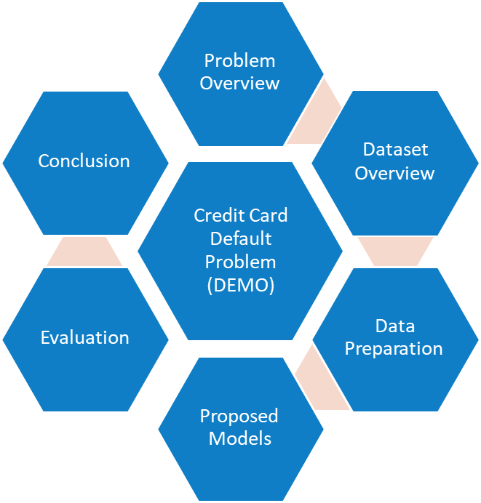
Agenda

Slide 3
Overview
The term “Fake News” was a lot less unheard of and not prevalent a couple of decades ago but in this digital era of social media, it has surfaced as a huge monster. Fake news, information bubbles, news manipulation and the lack of trust in the media are growing problems within our society.
Measuring fake news or even defining it properly could very quickly become a subjective matter, rather than an objective metric. In its purest form, fake news is completely made up, manipulated to resemble credible journalism and attract maximum attention and, with it, advertising revenue.

Slide 4
Defining fake news
These are articles that
Are blatantly false
Provide a truthful event but with some false interpretations
Are pseudoscientific
Are just opinion pieces disguised as news
Are comprised of mostly tweets and quotes from other people

Slide 5
Goal
The model we built here will use all possible factors to predict data to find Fake and non fake news.

Slide 6
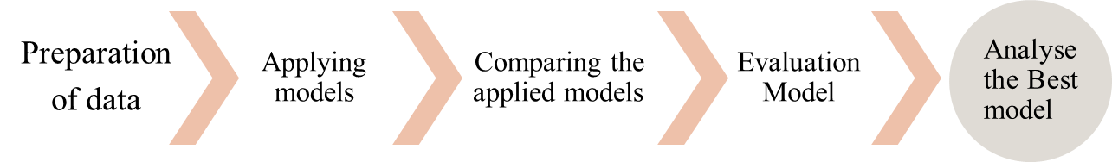
Approach design

Slide 7
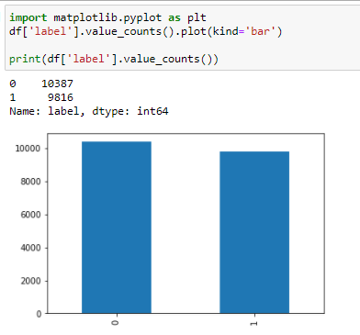
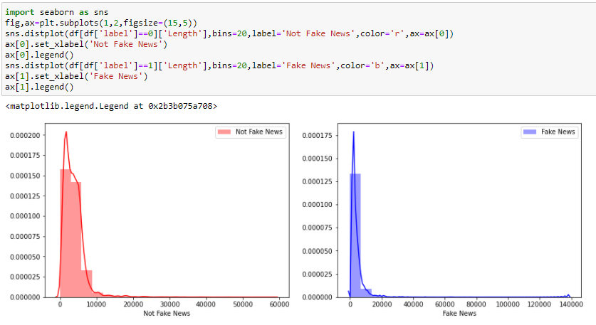
Dataset overview
Graph shows total number of records for fake and not fake news.
In this case, Label ‘1’ indicates that the news is fake
Label ‘0’ indicates that the news is not fake
49% - fake
51% - non-fake
And the characters in fake news are less than non-fake news

Slide 8
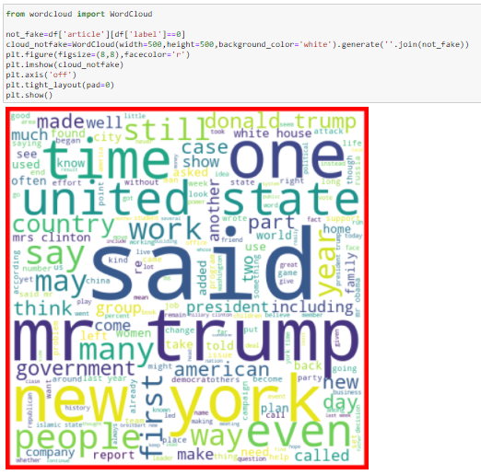
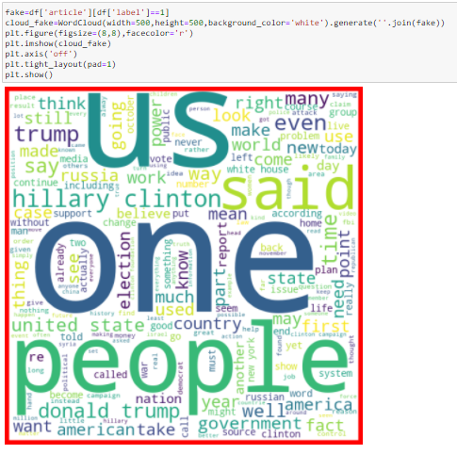
Word cloud is a straight forward way to demonstrate the most common words in fake and real news.
real
Fake

Slide 9
Data Preprocessing
Data set is divided in 70:30 ratio for train and test respectively.
'Unnamed: 0','id','written_by’ are dropped as its unnecessary for our modeling.
Drop null values from the dataset.
then tried with TF-IDF as Feature Vectors And then combined them with extracted features from Feature Engineering to build a model classifier.

Slide 10
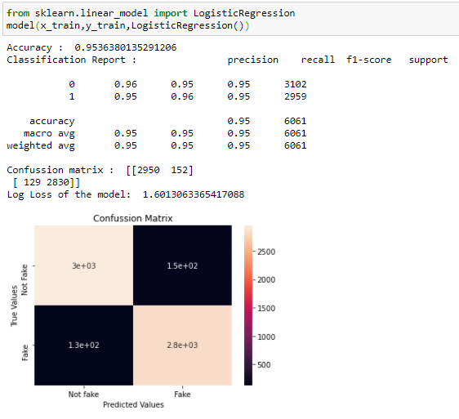
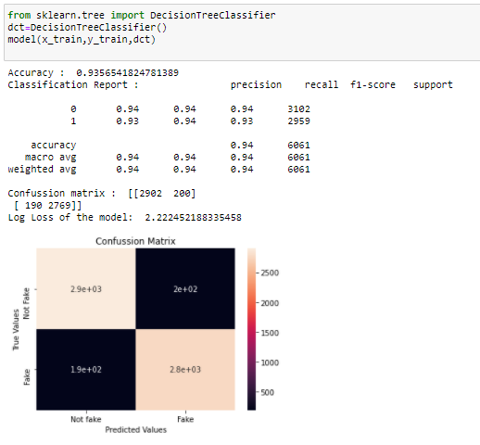
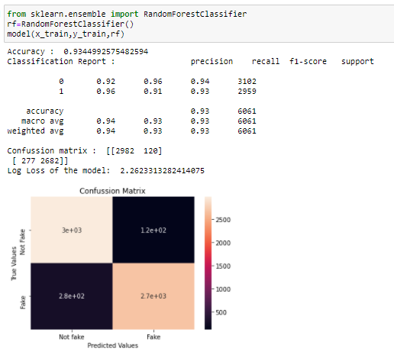
Applying classification algoritms
Logistic regression
Decision tree classifier
Random forest classifier

Slide 11
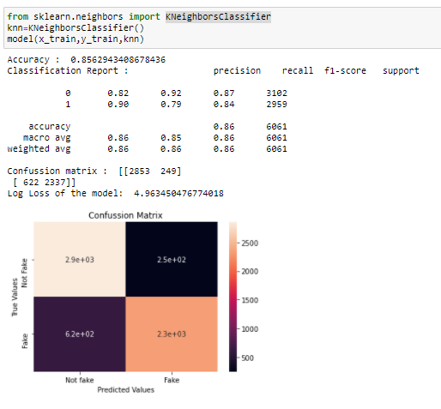
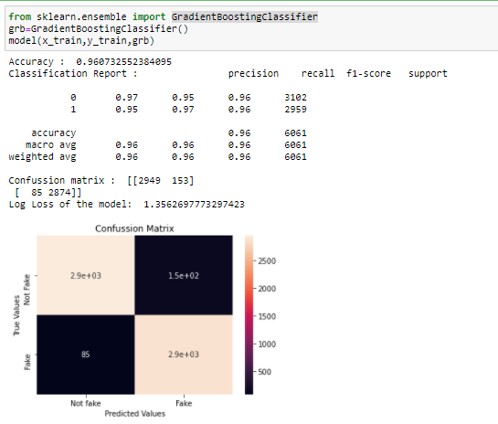
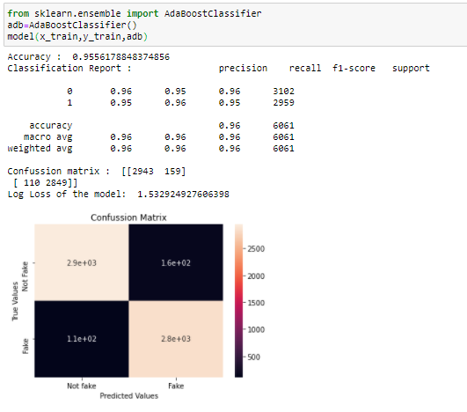
Kneighbors Classifier
Gradient Boosting Classifier
AdaBoost Classifier

Slide 12
Evaluation Process
Evaluation Metrics:
Accuracy: Accuracy determine how often the model predicts default and non-default correctly.
Precision: Precision calculates whenever our models predicts it is default how often it is correct.
Recall: Recall regulate the actual default that the model is actually predict.
Precision Recall Curve: PRC will display the tradeoff between precision and recall threshold.
Log loss: loss is a number indicating how bad the model's prediction was on a single example. If the model's prediction is perfect, the loss is zero; otherwise, the loss is greater.

Slide 13
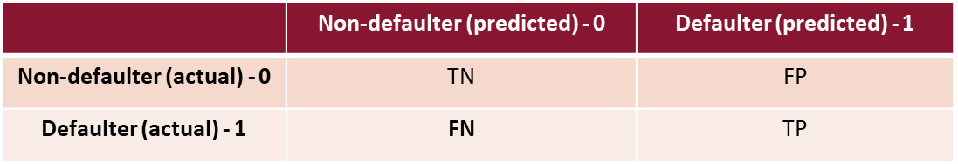
Confusion Metrics
True Positive – A person who is defaulter and predicted as defaulter.
True Negative – A person who is non-defaulter and predicted as non-defaulter.
False Positive – A person who is predicted defaulter is non-defaulter.
False Negative – A person who is predicted non-defaulter is defaulter.

Slide 14
Conclusion
Text analytics and NLP can be used to work with the very important problem of fake news. We’ve built a machine learning model using given data for detecting fake articles. You will need first to collect the data, We took a Fake news dataset, implemented a TfidfVectorizer, initialized different classifiers, and fit our model. We ended up obtaining an accuracy of 96% in magnitude with gradient boosting classifier.

Slide 15
Thank you

